Slide 1

Student Performance Analytics
Real-time insights, predictions, and motivation for learners
Intervarsity Hackathon 2025
Demo-ready Concept
Zeeshaan Ebrahim
Abongile Njokwana

Slide 2
The Challenge: Delayed & Disconnected Feedback
Current educational systems often leave students in the dark about their academic standing until it's too late to make a significant difference. This creates a reactive learning environment rather than a proactive one.
Delayed Feedback
Lack of Context
No Early Warning
Marks arrive after the fact, severely limiting a student's opportunity to understand and improve. The window for intervention closes before it even opens.
A raw score of 62% is meaningless without context. Students lack insight into their trends, how they compare to peers, or what specific goals they should set.
Without alerts or predictive insights, students (and educators) cannot intervene before the risk of failure becomes critical, leading to unnecessary academic struggles.

Slide 3



Our Solution: A Dynamic Performance Dashboard
We propose an intuitive, real-time analytics dashboard designed to empower students with actionable insights into their academic journey, fostering proactive learning and motivation.
Live Tracking
Predictive Scores
Gamified Badges
A unified timeline visualizes tasks, marks, and academic trends as they happen, providing a clear overview of progress.
Our model suggests expected future scores with a confidence interval, allowing for early identification of potential issues.
Achieve "Bronze" to "Diamond" status through progress and milestones, transforming learning into an engaging, goal-oriented experience.

Slide 4

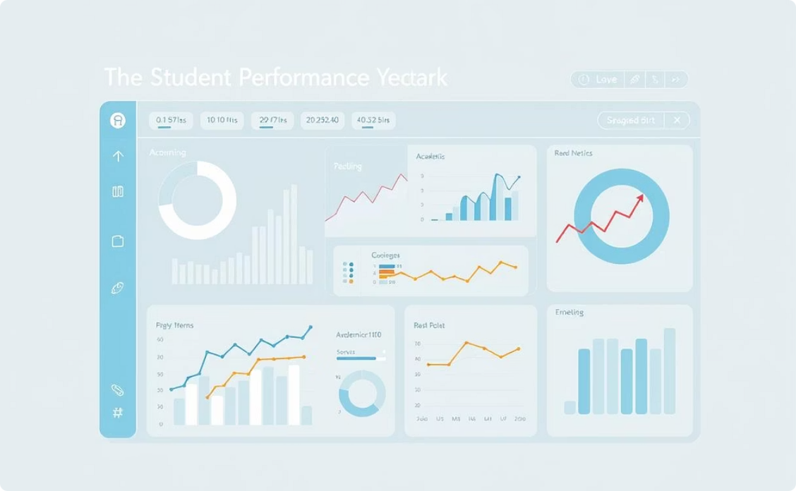


Demo Walkthrough: From Login to Insight
Experience how students gain immediate value from our interactive dashboard. The journey is seamless, guiding users through critical academic information.
Login
Dashboard
Secure access to personalized academic data and tools.
Comprehensive overview of academic progress, tasks, and trends.
Insights
Prediction
In-depth understanding of strengths and areas for improvement.
Anticipate future outcomes and plan proactively for success.
Our demo showcases the intuitive navigation and the power of immediate access to performance data.

Slide 5
Key Features: Value for Students & Universities
Our platform provides immediate benefits, enhancing both student engagement and institutional oversight from day one.
1
2
Secure Login
Percentile Insights
Student ID-based authentication ensures secure access to personalized dashboards, protecting sensitive academic data.
Students can see their standing relative to their peers in real-time, offering valuable competitive and comparative context.
3
4
Motivating Badges
Task Management
Milestone badges keep motivation high, celebrating progress and encouraging continuous effort in academic pursuits.
An integrated view of upcoming tasks and deadlines helps students stay organized and prioritize their academic workload effectively.

Slide 6
Robust & Scalable Architecture
Our platform is built on modern, reliable technologies, ensuring a simple, efficient, and high-performance pipeline.
Frontend
Backend
Data & Security
React (Vite/TS): Fast, interactive user interface built with Vite and TypeScript for robust development.
FastAPI: High-performance Python REST API for efficient data processing and serving.
CSV Data: Flexible input for assessments and enrollment data, easily integrated.
Regression Models: Utilized for accurate predictive analytics of student performance.
Authentication: Token-based sessions across frontend and backend containers ensure secure user access.

Slide 7


Impact: Transforming Academic Outcomes
Our solution bridges the gap between passive learning and active engagement, turning academic blind spots into actionable insights.
Before
After
Marks appear weeks later, with no trend visualization.
Real-time performance tracking and percentile insights.
No early alerts or predictive warnings for at-risk students.
Proactive early warnings and personalized goal setting.
Limited and often delayed support for struggling learners.
Gamified achievements foster continuous motivation and engagement.

Slide 8



Roadmap: Beyond the MVP
Our vision extends beyond the current prototype, with exciting future developments planned to further enhance student success.
Study Recommendations
Collaboration Features
Mobile Integration
Personalized suggestions for resources and study strategies, tailored to individual weak areas.
Integrated tools for peer group formation, tutoring nudges, and collaborative learning spaces.
On-the-go check-ins, real-time alerts, and performance summaries directly to student mobile devices.

Slide 9

Give Students the Right Nudge at the Right Time
Our Student Performance Analytics platform is designed to transform the learning experience, making academic success more attainable and transparent for every student.
Our Ask: Partnership for Progress
We are seeking pilot access to anonymized module data from universities to validate our predictive models across diverse cohorts. This collaboration will allow us to refine our algorithms and ensure maximum impact for your students.

